Slide 1
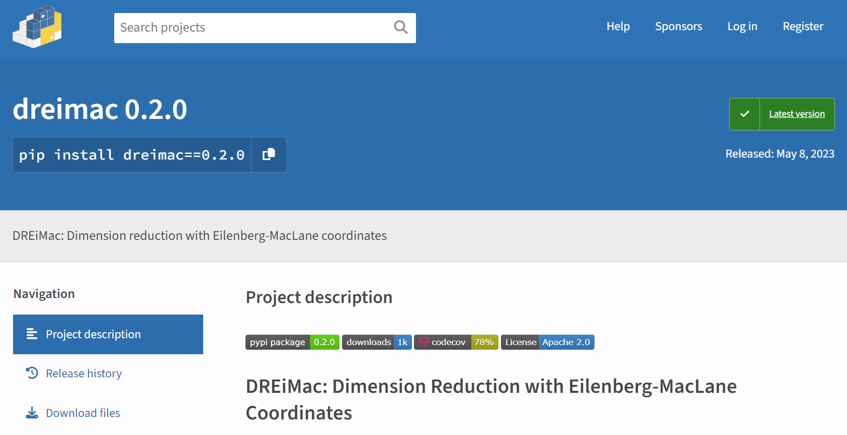
https://github.com/scikit-tda/DREiMac

Slide 2

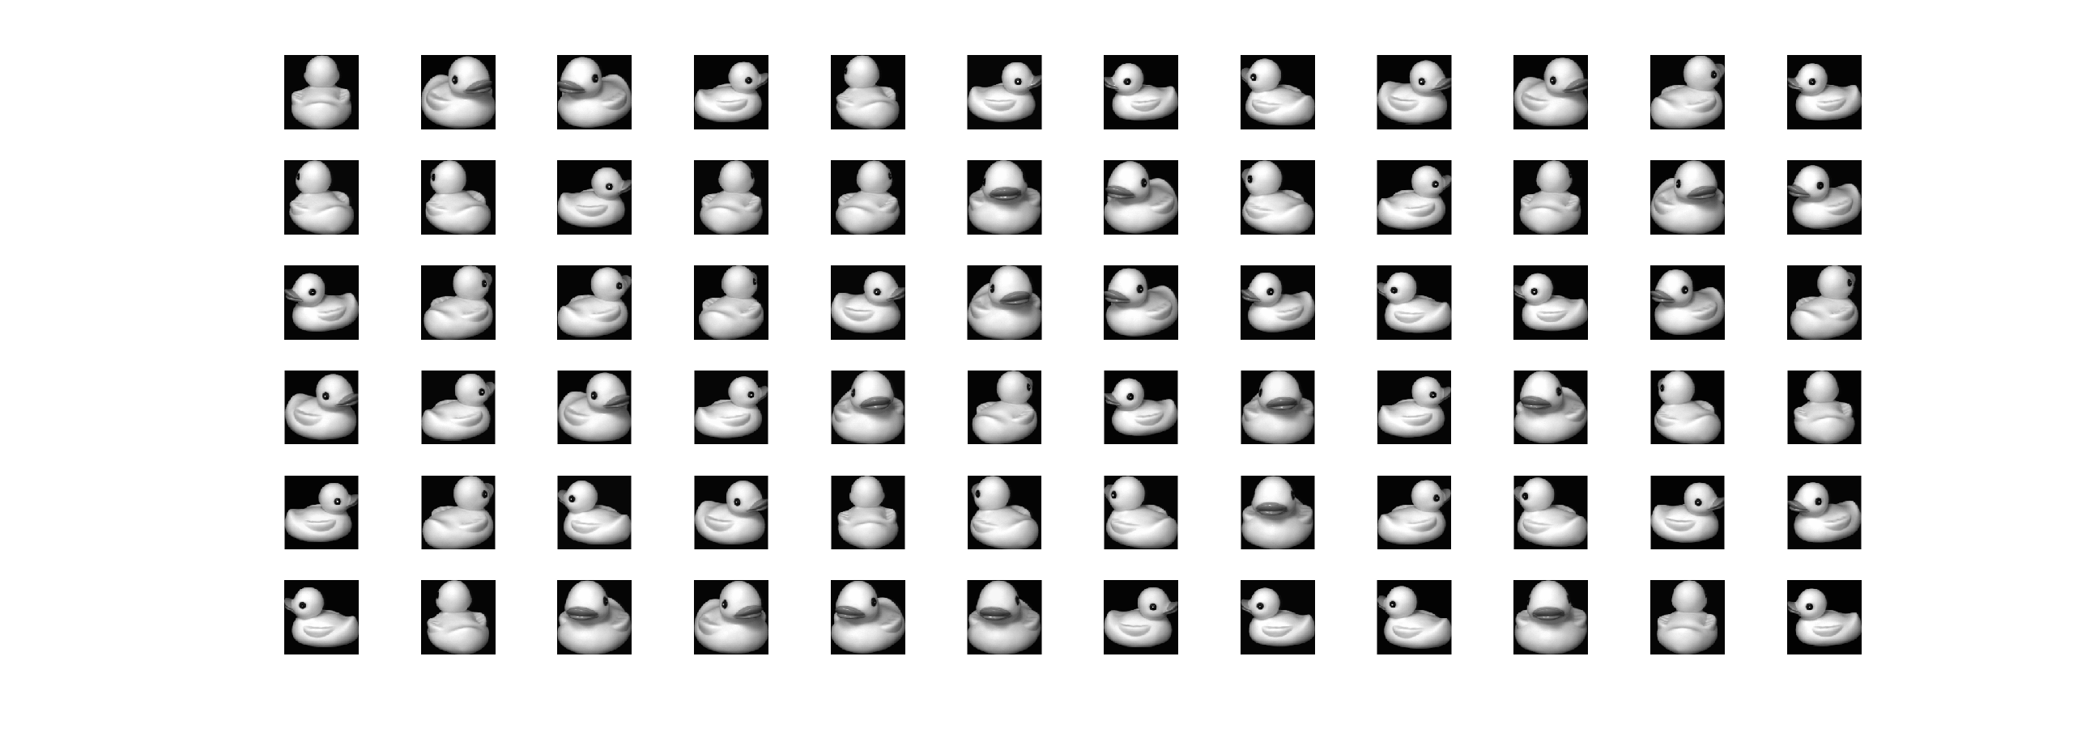
Example 1
Data
https://www.cs.columbia.edu/CAVE/software/softlib/coil-20.php

Slide 3
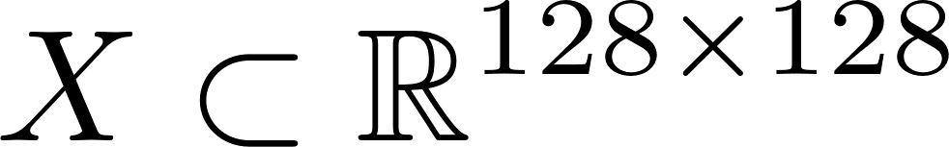
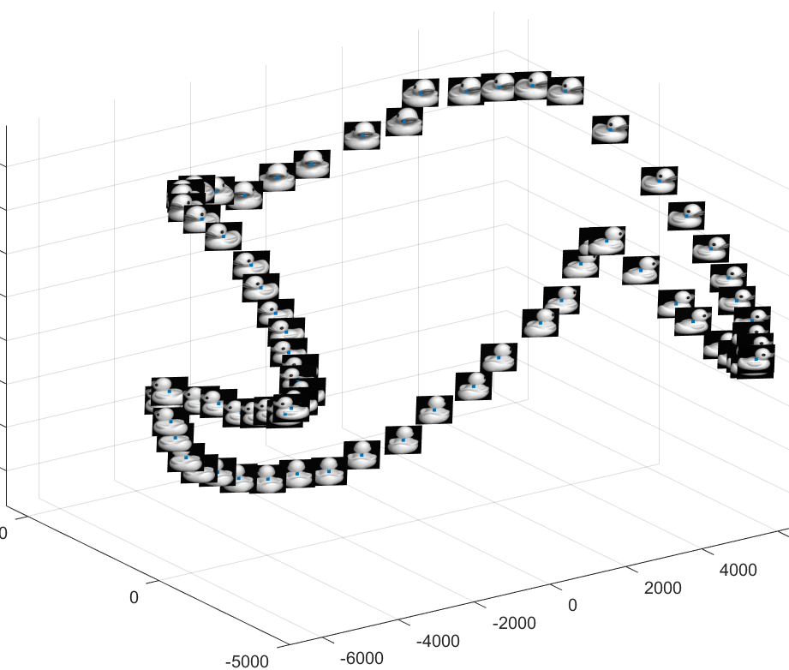

PCA Visualization
Dimensionality
Reduction
https://www.cs.columbia.edu/CAVE/software/softlib/coil-20.php

Slide 4
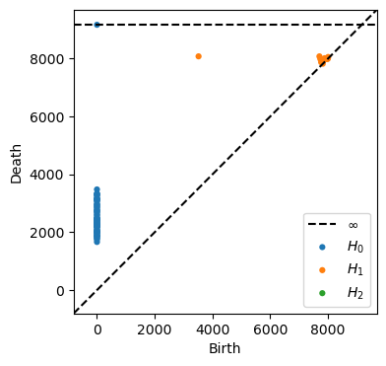

The persistent cohomology of data
https://www.cs.columbia.edu/CAVE/software/softlib/coil-20.php

Slide 5
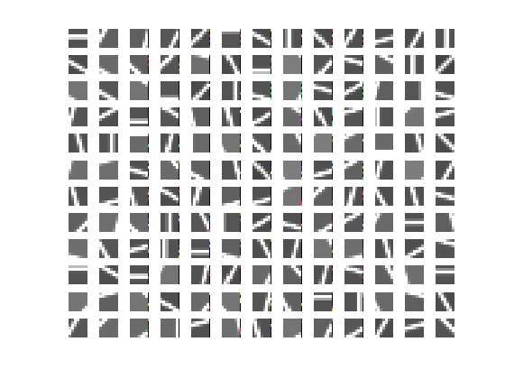
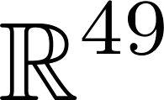
Example 2
7 × 7 grey-scale images depicting a single straight line
subset of , via column concatenation

Slide 6
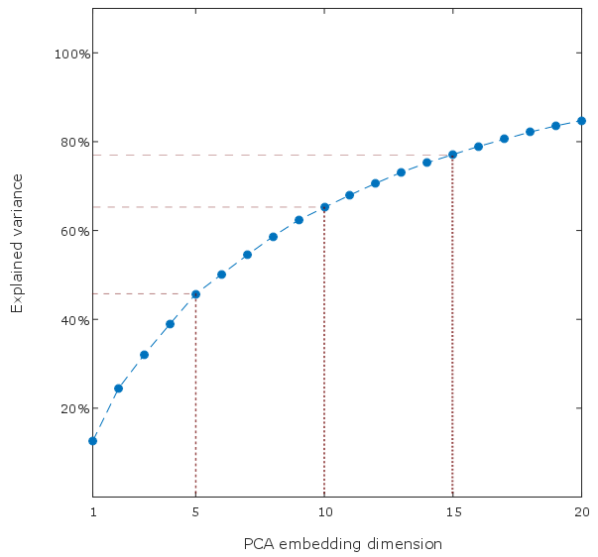
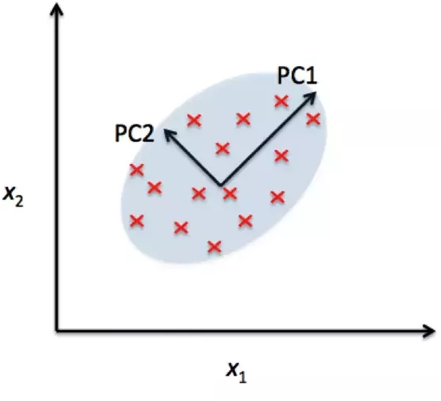
Principal Component Analysis (PCA)

Slide 7
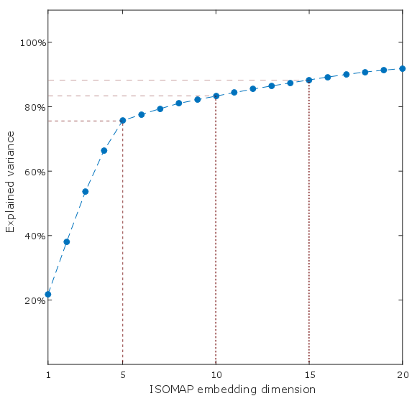

Slide 8
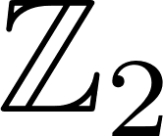
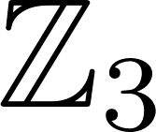
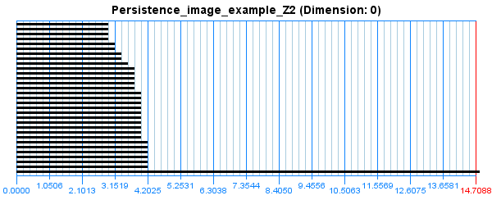


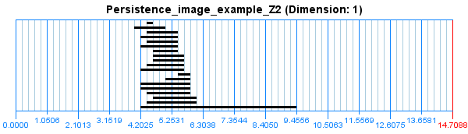
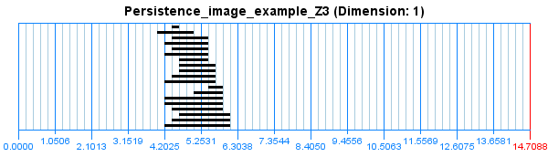

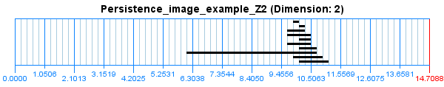
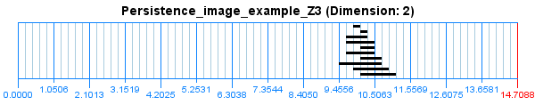
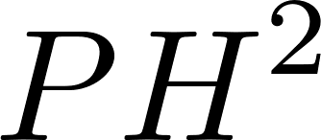

Slide 9



The Projective Plane
Notes:
Do this for all points in the boundary, and leave the points in the interior untouched.
It is entirely possible that you have some skepticism and that you think that mapping a data set to this space is not a reasonable thing. So let me give you an example to keep in mind.

Slide 10

???
Suggested model
Data

Slide 11
Eilenberg-MacLane Coordinates

Slide 12
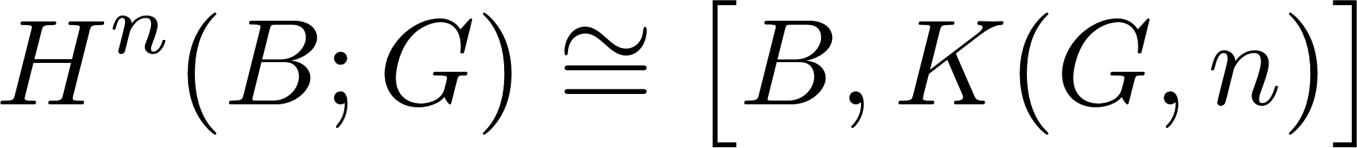
Theorem:
CW-complex
Homotopy classes of maps
Eilenberg-MacLane Space
Abelian group

Slide 13
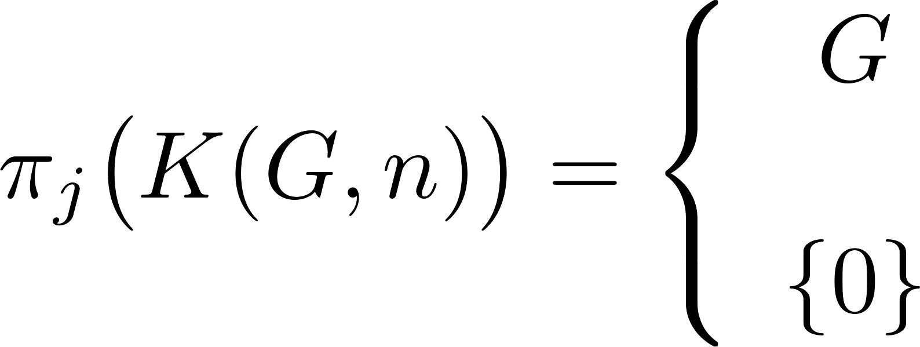
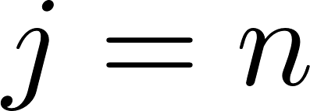
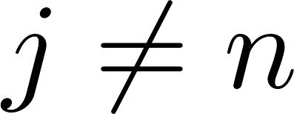
Theorem:
Where

Slide 14

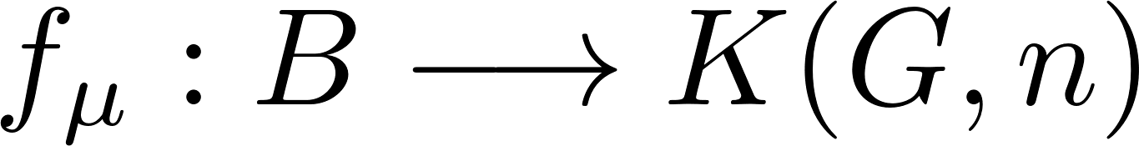






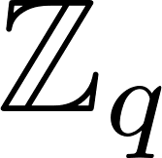
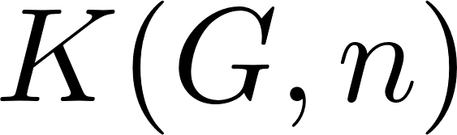



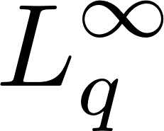

Eilenberg-MacLane Coordinates

Slide 15
https://github.com/scikit-tda/DREiMac

Slide 17


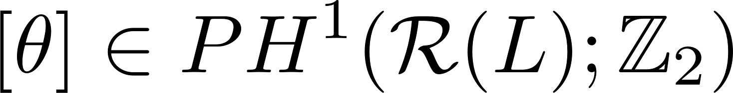

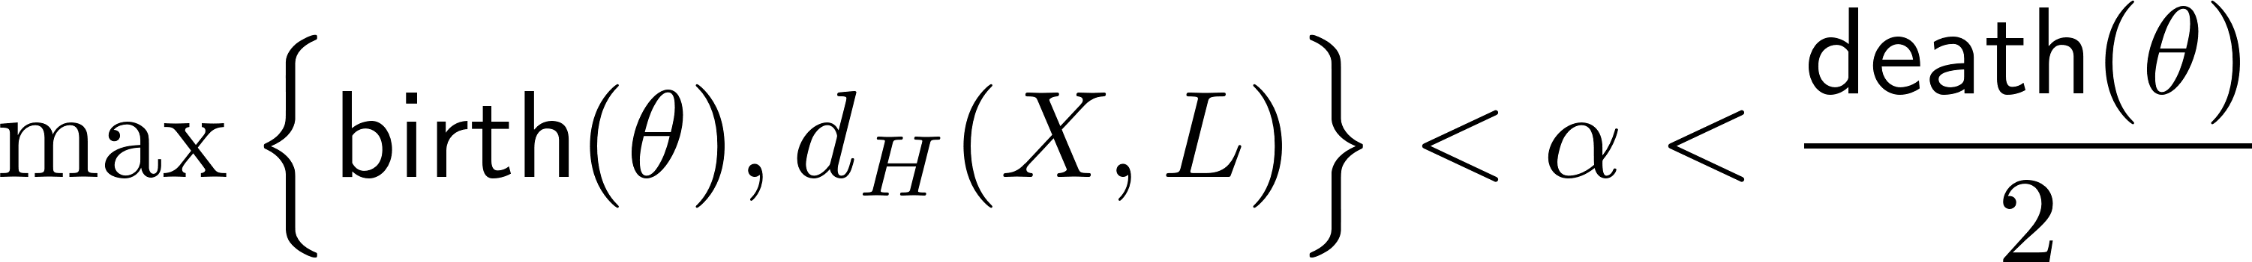
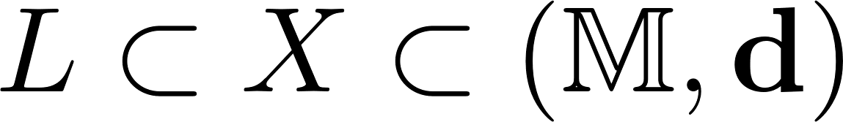
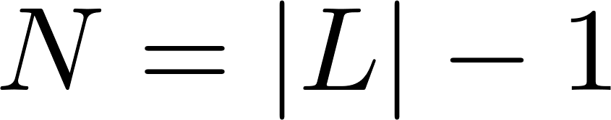
Projective coordinates
Rips filtration
Data set
Landmarks
Multiscale Projective Coordinates via Persistent Cohomology, J. Perea, D&CG, 2018

Slide 18

7 × 7 grey-scale images of a line
THiS!!
Multiscale Projective Coordinates via Persistent Cohomology, J. Perea, D&CG, 2018

Slide 19
Projective coordinates
THiS!!
Multiscale Projective Coordinates via Persistent Cohomology, J. Perea, D&CG, 2018

Slide 20

Projective coordinates
THiS!!
Supports a version of Principal Component Analysis
(Projective PCA)
Multiscale Projective Coordinates via Persistent Cohomology, J. Perea, D&CG, 2018

Slide 21
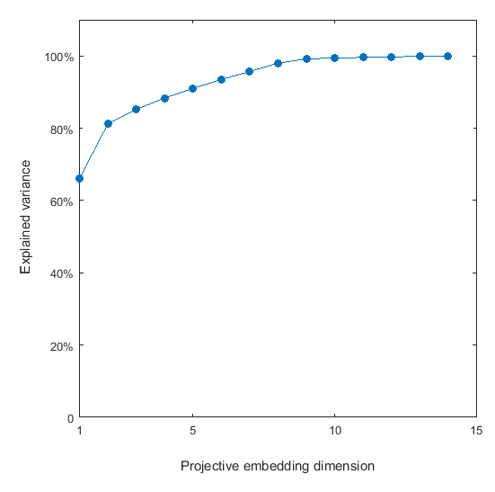
Projective coordinates
Variance: Projective PCA
Supports a version of Principal Component Analysis
(Projective PCA)
Multiscale Projective Coordinates via Persistent Cohomology, J. Perea, D&CG, 2018

Slide 22
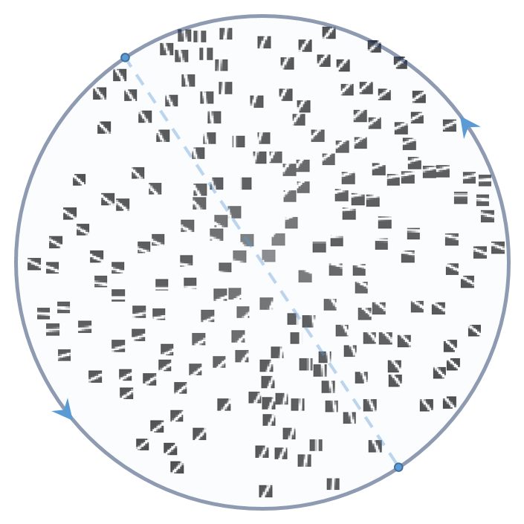
Projective coordinates
Supports a version of Principal Component Analysis
(Projective PCA)
Data
Multiscale Projective Coordinates via Persistent Cohomology, J. Perea, D&CG, 2018

Slide 24
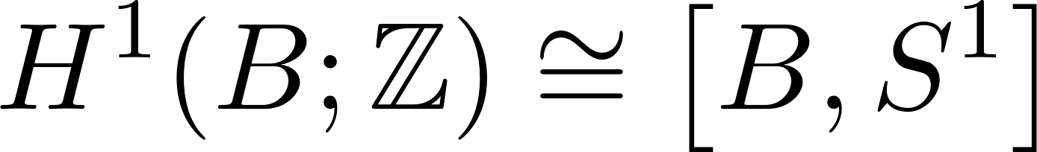
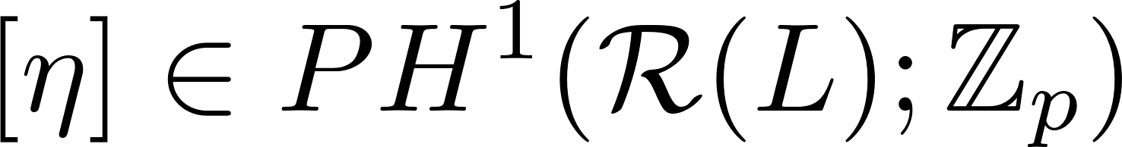
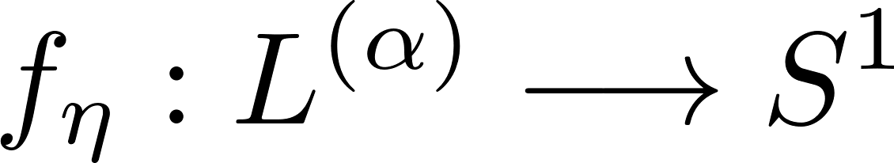
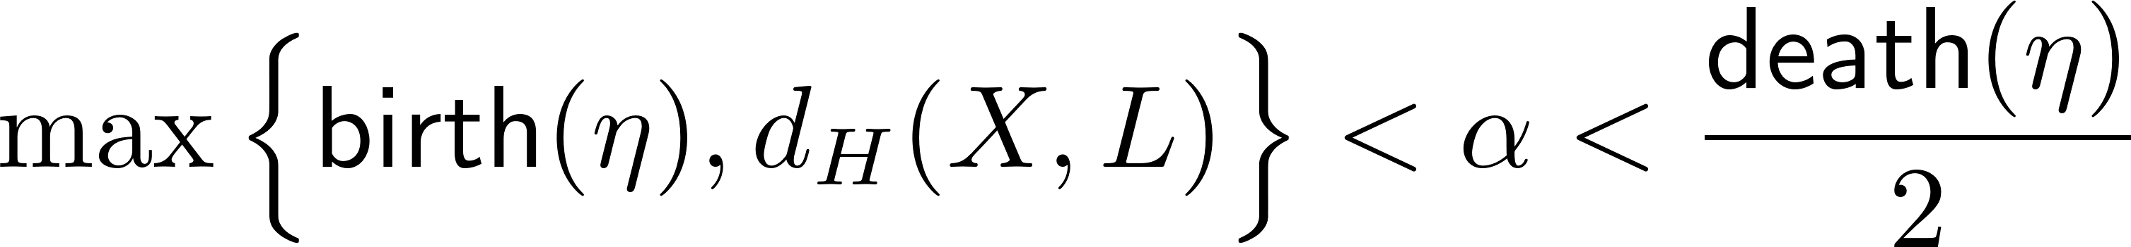

Circular coordinates
Rips filtration
Small random prime
or
Large prime
Data set
Landmarks
Sparse Circular Coordinates via Principa -Bundles, J. Perea, 15th Abel Symp, 2020

Slide 25

Data
https://www.cs.columbia.edu/CAVE/software/softlib/coil-20.php

Slide 26
https://www.cs.columbia.edu/CAVE/software/softlib/coil-20.php

Slide 27

Cohomology and Circular Coordinates
https://www.cs.columbia.edu/CAVE/software/softlib/coil-20.php

Slide 28

Cohomology and Circular Coordinates
https://www.cs.columbia.edu/CAVE/software/softlib/coil-20.php

Slide 29
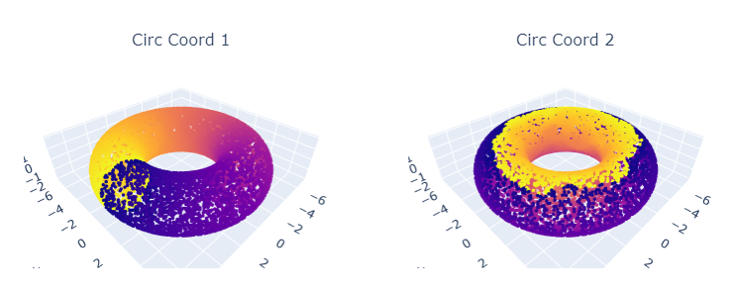
Python Demo
https://github.com/scikit-tda/DREiMac

Slide 30
MSRI-UP 2023
Topological Data Analysis
https://github.com/joperea/MSRI-UP2023/
https://github.com/scikit-tda/DREiMac

Slide 31
Open a terminal (anaconda powershell) and
Install the DREiMac library:
pip install git+https://github.com/scikit-tda/DREiMac.git@experimental

